Slide 1

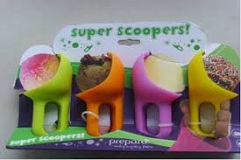
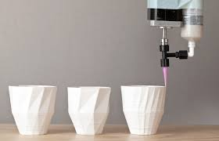
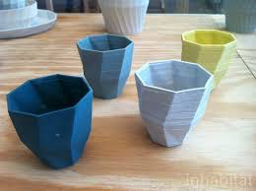
Westerdals
Design iterations: Ice cream cup
jakob.a.nilsson@gmail.com

Slide 2
The week
Fyll in doodle om status på itslearning
Vilka färger vill ni ha? Poll på Onsdag
Cad support i klassrum
Onsdag: 9:15-11:00
Torsdag: 9:15-10:00
Fredag: 9:15-11:00
Support in makerspace
Onsdag: 11:00-12:00
Torsdag: 10:00-12:00
Fredag: 11:00-12:00

Slide 3
Product development plan
Week1: Learn CAD and 3D print - DONE!
Week2: Design iterations and testing
Week3: Produce functional prototype
Week4: Reporting etc
Design your product for for batch printing.
The final production optimization is not part of the course since that would be done in collaboration with the print farm supplier.

Slide 4

This weeks goals - Design iterations and testing
Establish requirements
Client needs
End user needs
Manufacturing needs
Course needs
Personal goals
Generate, develop, review, iterate concepts until you have
Tested that your concept fulfills the requirements
Will it print?
Function tests?
User test?
Changes needed?
More test needed or Good enough?
Notes:
Not tested the whole thing but parts.
Scale ambition!
if you want to be able to alter it, otherwise it isn’t testing its delivery
Planning vs Creative mindset. Very hard to be both at once
Make a plan of how developed you need to be at milestone times to give your mind peace to work. Where do you need to be when?
Functional prototypes, manufacturers input, learn limitations test limitations, test feel of final product (try hard to test the right function)
Gather needs from stakeholders (also practical),Concept generation, culling, development, fair evaluation. Update needs, do a refinement loop with improvement concept, culling, development, fail eval

Slide 5
Next weeks goals - Produce functional prototype
Final design tweaks
Manufacture functional prototype (problems & revisions)
Make drawings of the final design
Make renderings
Very limited time to test, redesign and reprint in this week!
Meaning if you test something in this week and don’t like it you will not have time to change it!
Notes:
Will it print. User testing (if you want to be able to alter it, otherwise it isn’t testing its delivery)

Slide 6


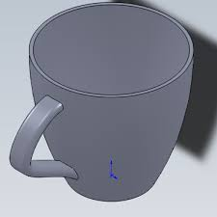
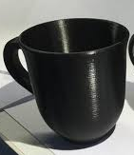
Iterations and refinement
Sketches
Models
Prints
Iterations takes more time but you learn more
Notes:
avoiding favouritism in eval, first idea gets an advantage

Slide 7
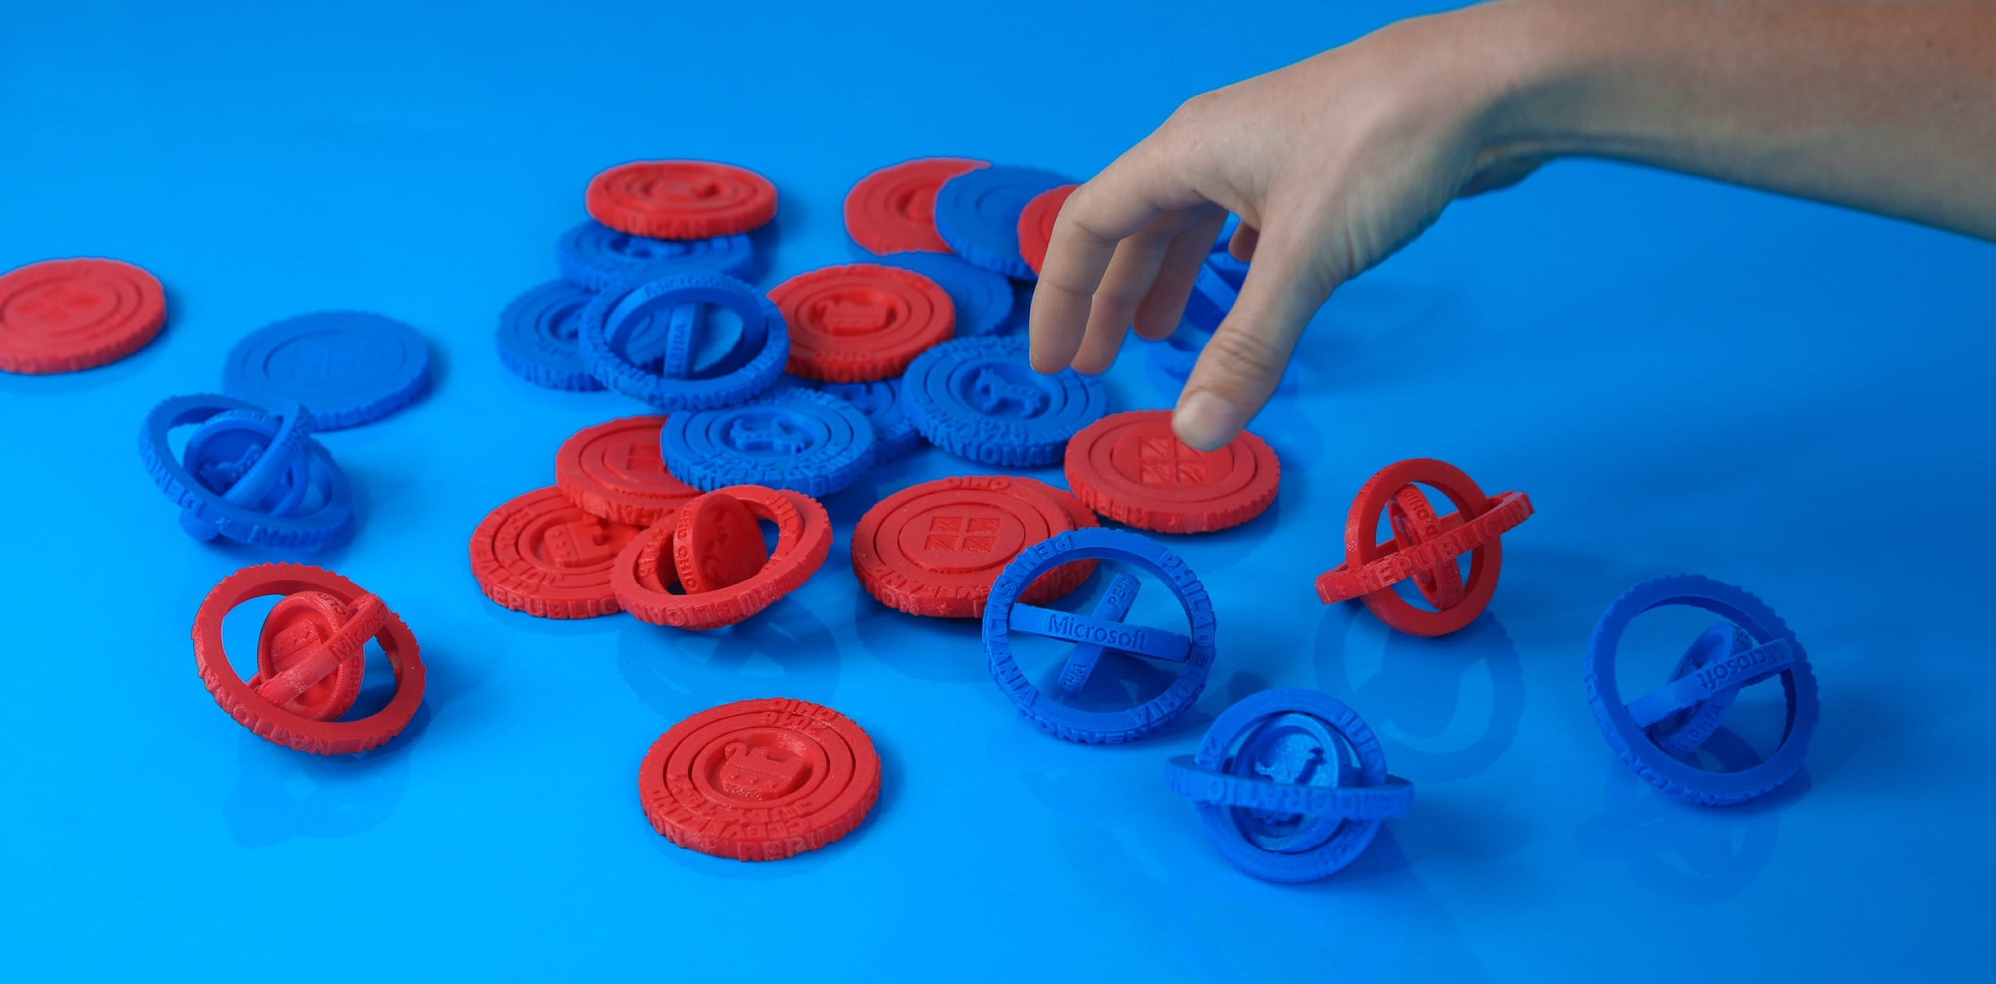
Course needs
Design your product to be batch printed
Mass production optimization is not required, functional prototype is the goal.
https://voodoomfg.com/examples/microsoft
Notes:
The final production optimizing is not part of the course since that would be done in collaboration with the print farm supplier.

Slide 8

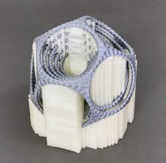
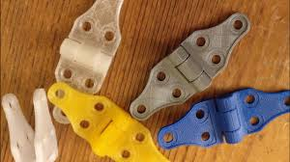
Special features, if you want them!
Moving parts
Can be printed as one part (like this 1 print elephant with moving legs)
Can be snapped together (like these car wheels)
Avoid complex manual assembly, especially using fasteners glue etc.
Support material
Is OK! But you will have to remove it yourself!
Worse surface finish
In batch production soluble support would be used (Ultimaker PVA example)
Consider if rotating the print solves the problem or if you can design around it?

Slide 9
Questions and problems?
Got SD card?
Got makerspace access?
Have setup Cura for both:
Ultimaker 2+ Exended (included in Cura)?
Type A machines Series 1 2013 (not included in Cura)?
Other questions?

Slide 10
Printer time use
Sharing the printers
There will be queues
Start testing early
Share your results
Check the expected print time!
Will it print?
Print test parts! You will want to change things.
Scale down the model
Divide the model
Strong and nice looking prints
0,15 to 0,2 mm layer height is good for testing
Lower layer height improves overhangs but is slow!
More than 15% infill is a waste of time, rarely needed
Notes:
save for wednesday?

